Slide 1
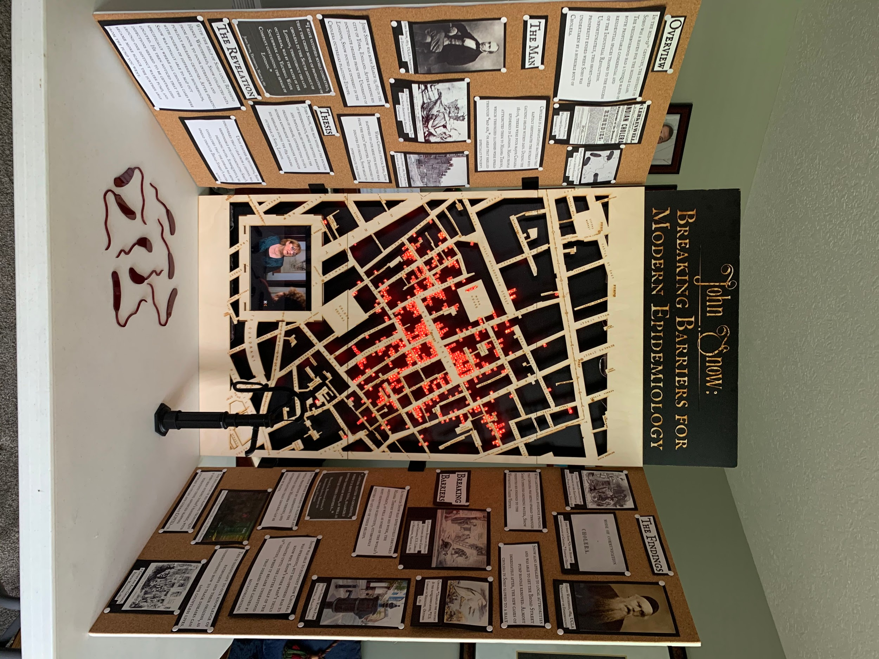
John Snow: Breaking Barriers for Modern Epidemiology

Slide 2
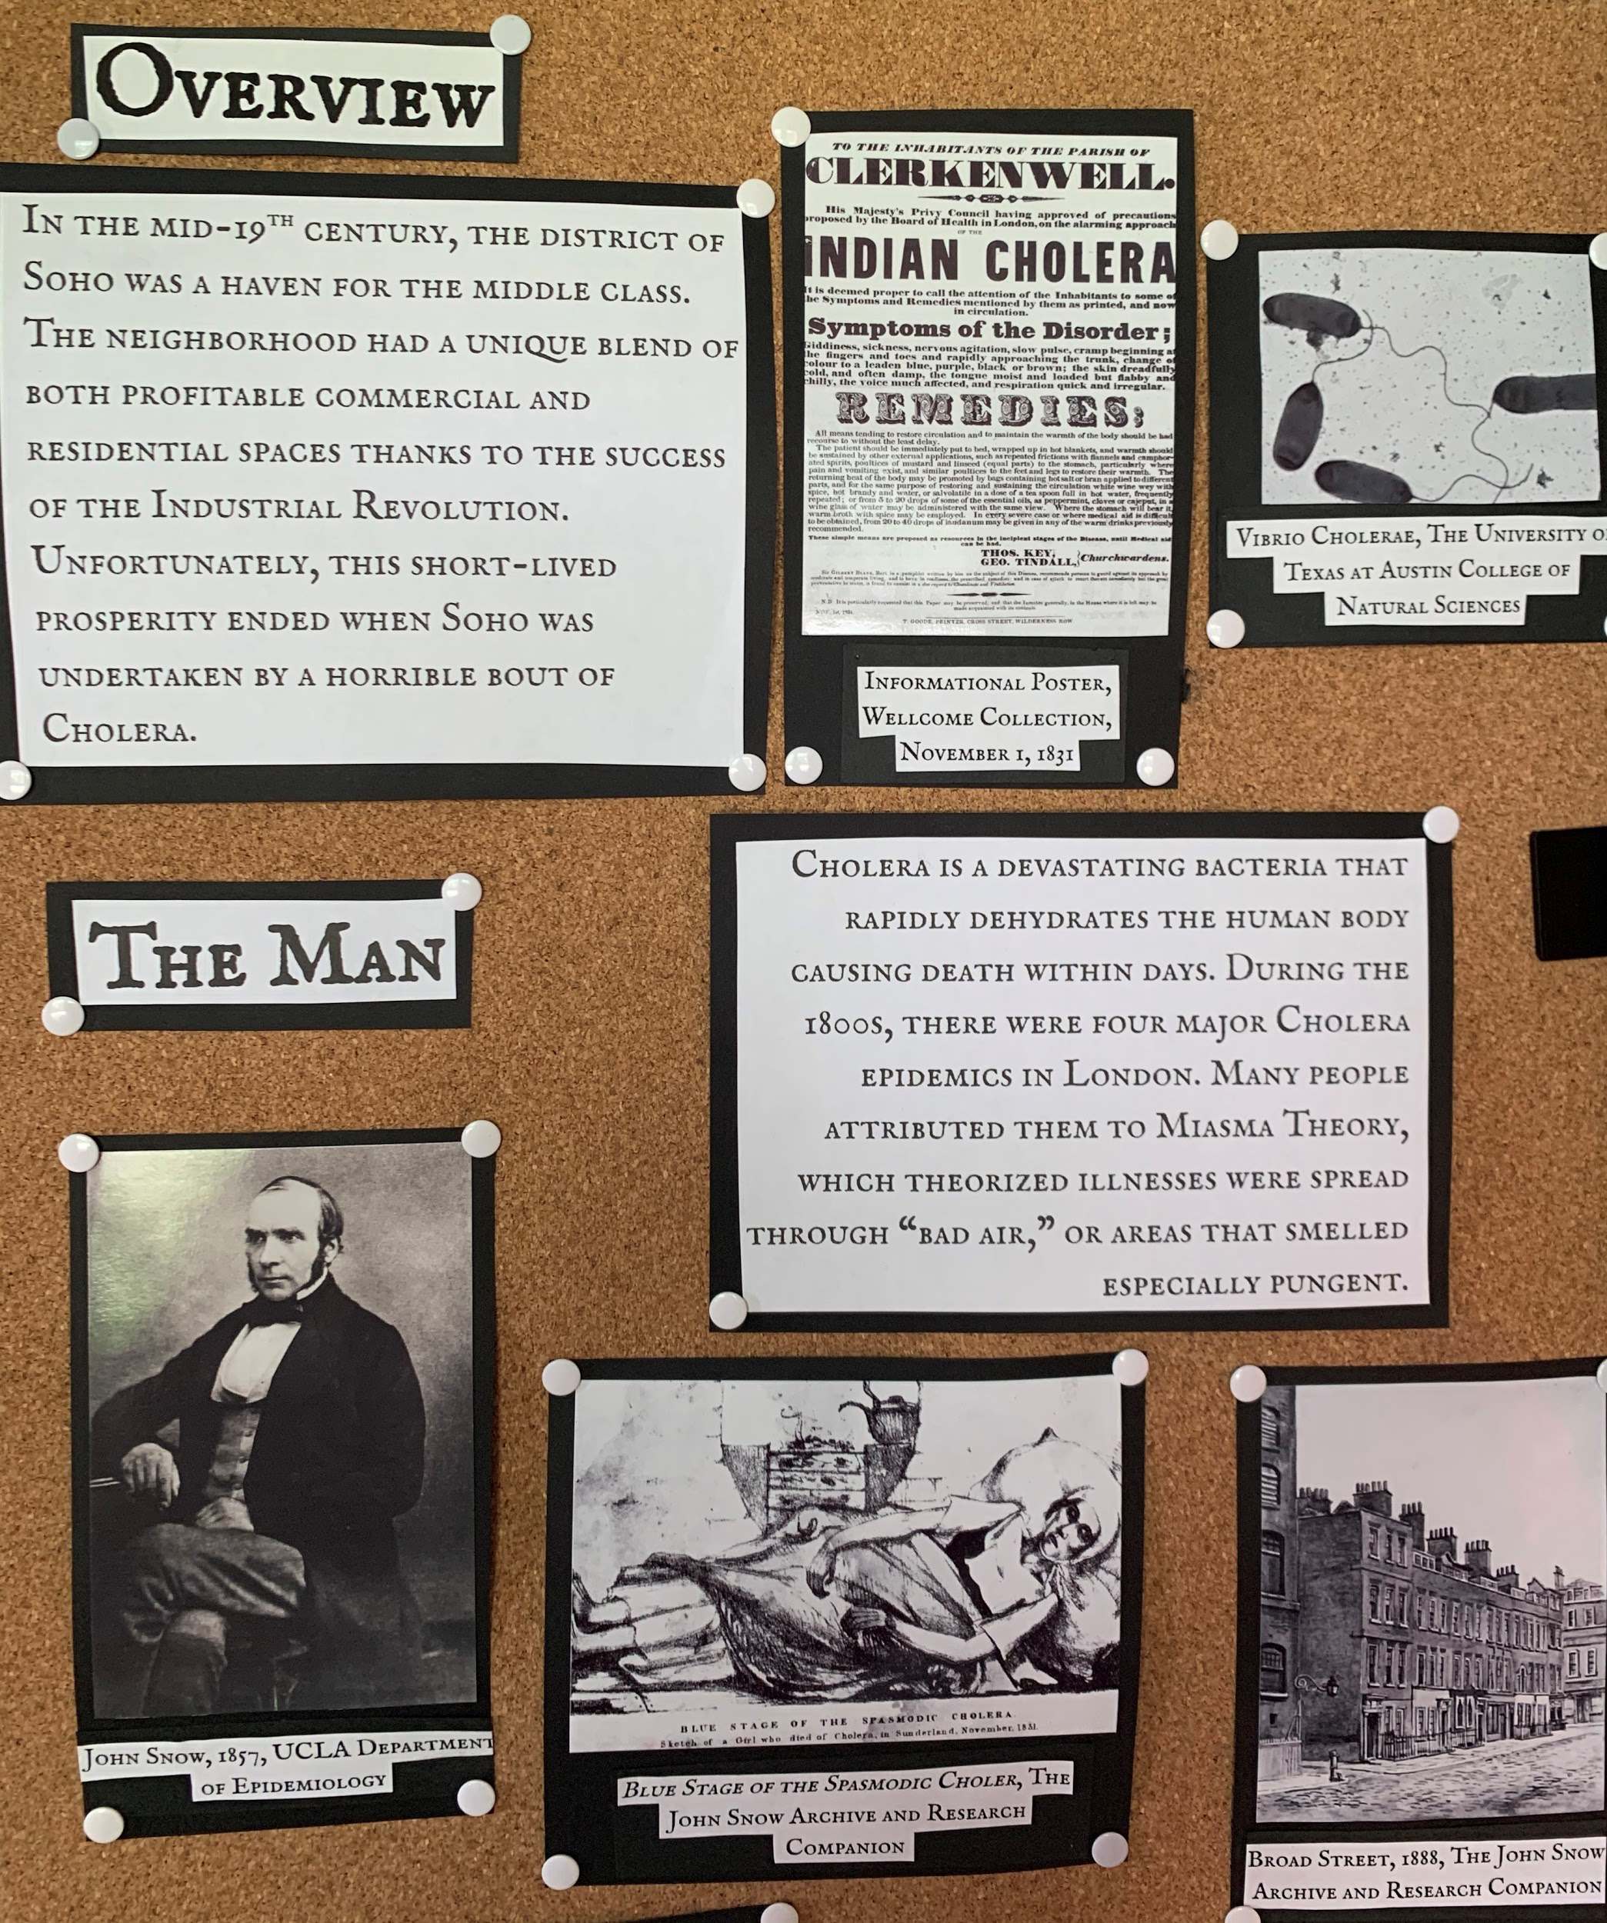
Left Panel Top Photo

Slide 3
Left Panel Top Text
Overview
In the mid-19th century, the district of Soho was a haven for the middle class. The neighborhood had a unique blend of both profitable commercial and residential spaces thanks to the success of the Industrial Revolution. Unfortunately, this short-lived prosperity ended when Soho was undertaken by a horrible bout of Cholera.
Cholera is a devastating bacteria that rapidly dehydrates the human body causing death within days. During the 1800s, there were four major Cholera epidemics in London. Many people attributed them to Miasma Theory, which theorized illnesses were spread through “bad air,” or areas that smelled especially pungent.

Slide 4
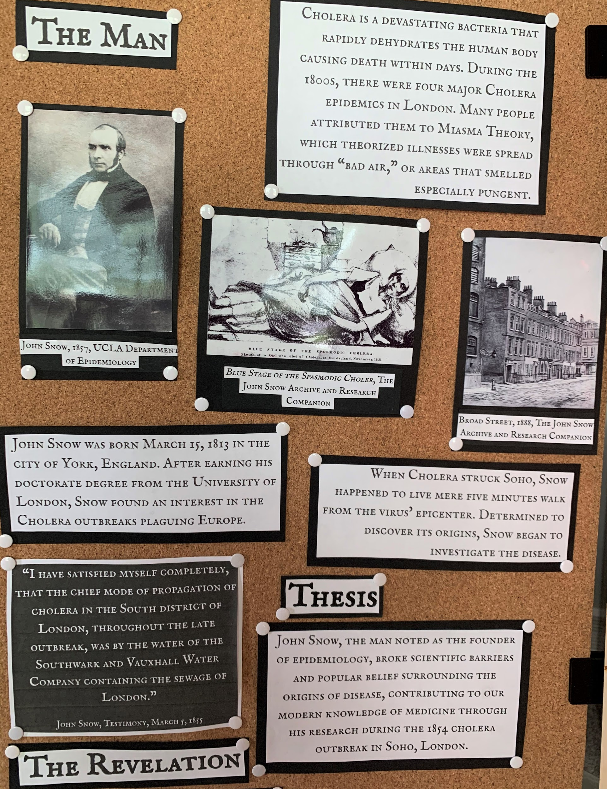
Left Panel Center Photo

Slide 5
Left Panel Center Text
The Man
John Snow was born March 15, 1813 in the city of York, England. After earning his doctorate degree from the University of London, Snow found an interest in the Cholera outbreaks plaguing Europe.
When Cholera struck Soho, Snow happened to live mere five minutes walk from the virus’ epicenter. Determined to discover its origins, Snow began to investigate the disease.
Thesis
John Snow, the man noted as the founder of epidemiology, broke scientific barriers and popular belief surrounding the origins of disease, contributing to our modern knowledge of medicine through his research during the 1854 cholera outbreak in Soho, London.

Slide 6
Left Panel Bottom Photo

Slide 7
Left Panel Bottom Text
The Revelation
With the help of Soho local Reverend Henry Whitehead, Snow collected data from door to door interviews and publicly released censuses. After speaking with Soho’s households, Snow was able to map out specifically where all cholera cases were located. He then noticed that the infections seemed to be centralized around one distinct water pump, and became more scarce the further away from the pump you went.
Upon further questioning, Snow discovered that a leak from a cesspool was responsible for contaminating Soho’s drinking water. Subsequently, he concluded that the disease was being spread through Broad Street’s water supply.
“I have satisfied myself completely, that the chief mode of propagation of cholera in the South district of London, throughout the late outbreak, was by the water of the Southwark and Vauxhall Water Company containing the sewage of London.”
-John Snow, Testimony, March 5, 1855

Slide 8
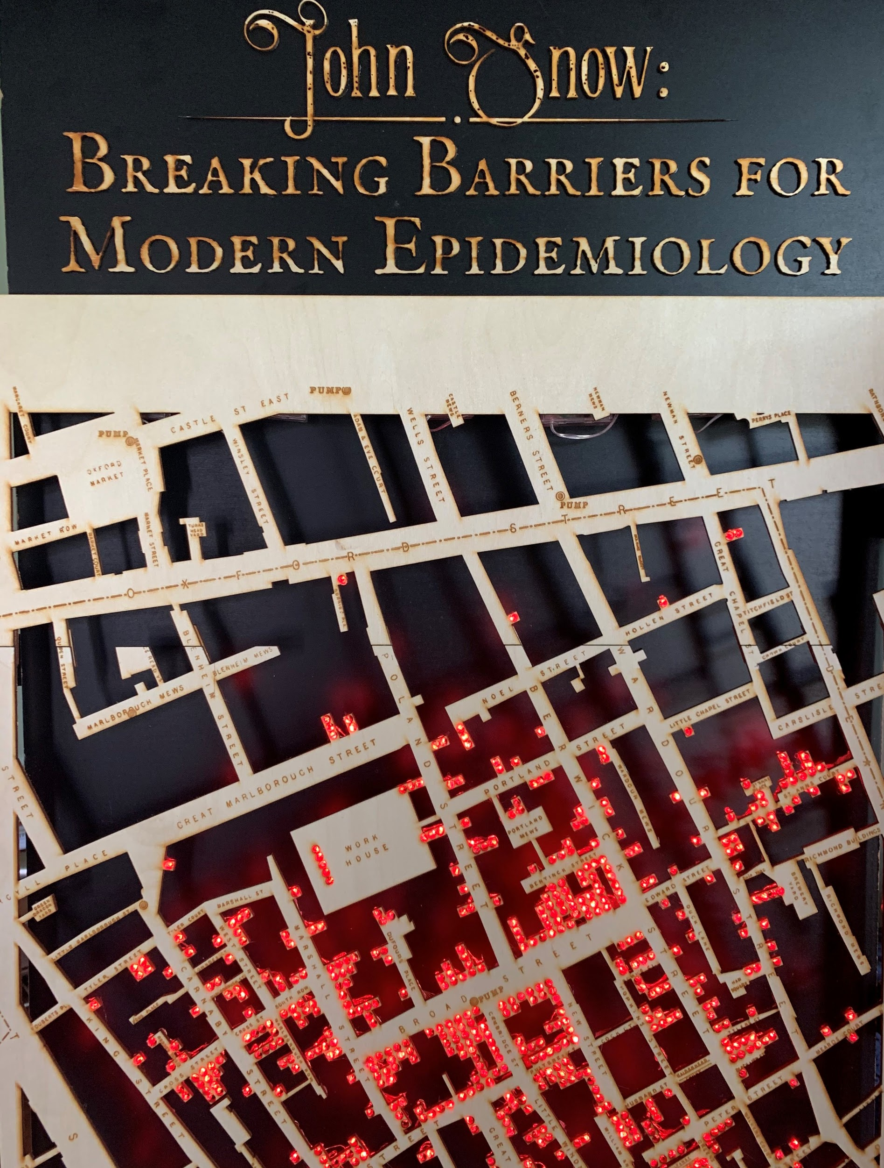
Center Panel Top Photo

Slide 9
Center Panel Top Text
John Snow: Breaking Barriers for Modern Epidemiology

Slide 10
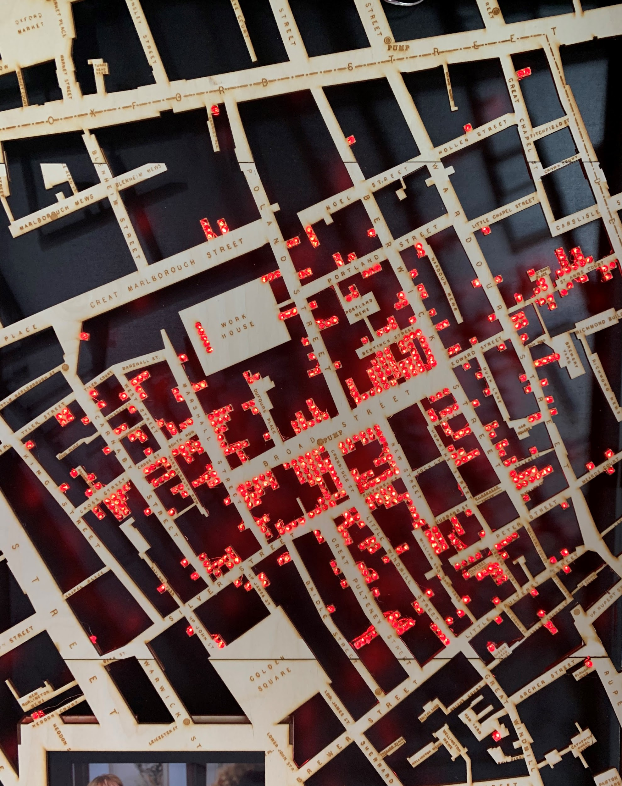
Center Panel Center Photo

Slide 11
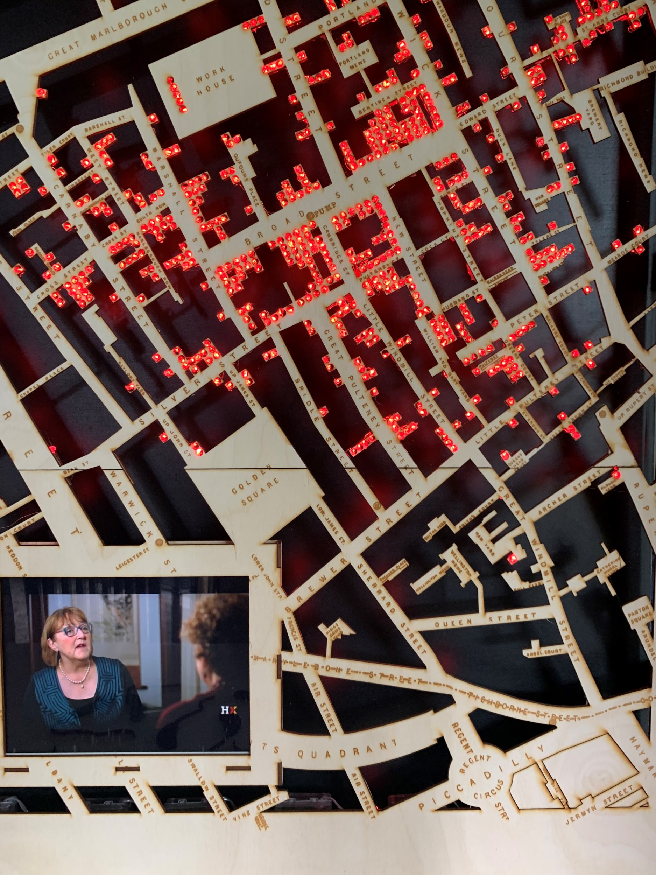
Center Panel Bottom Photo

Slide 12
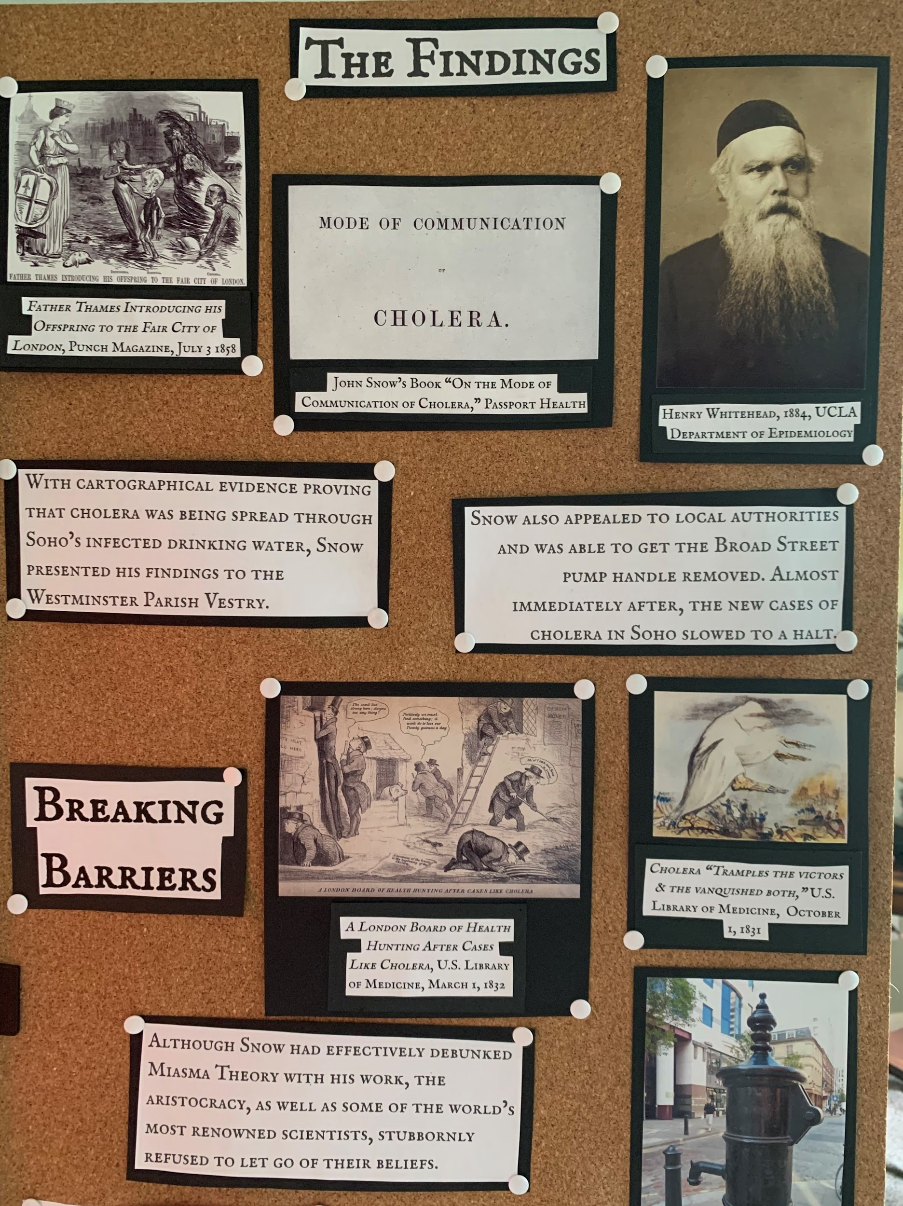
Right Panel Top Photo

Slide 13
Right Panel Top Text
The Findings
With cartographical evidence proving that cholera was being spread through Soho’s infected drinking water, Snow presented his findings to the Westminster Parish Vestry.
Snow also appealed to local authorities and sucessfully got the Broad Street pump handle removed. Almost immediately after, the new cases of cholera in Soho slowed to a halt.
Breaking Barriers
Although Snow had effectively debunked Miasma Theory with his work, the aristocracy, as well as some of England’s most renowned scientists refused to let go of their beliefs.

Slide 14
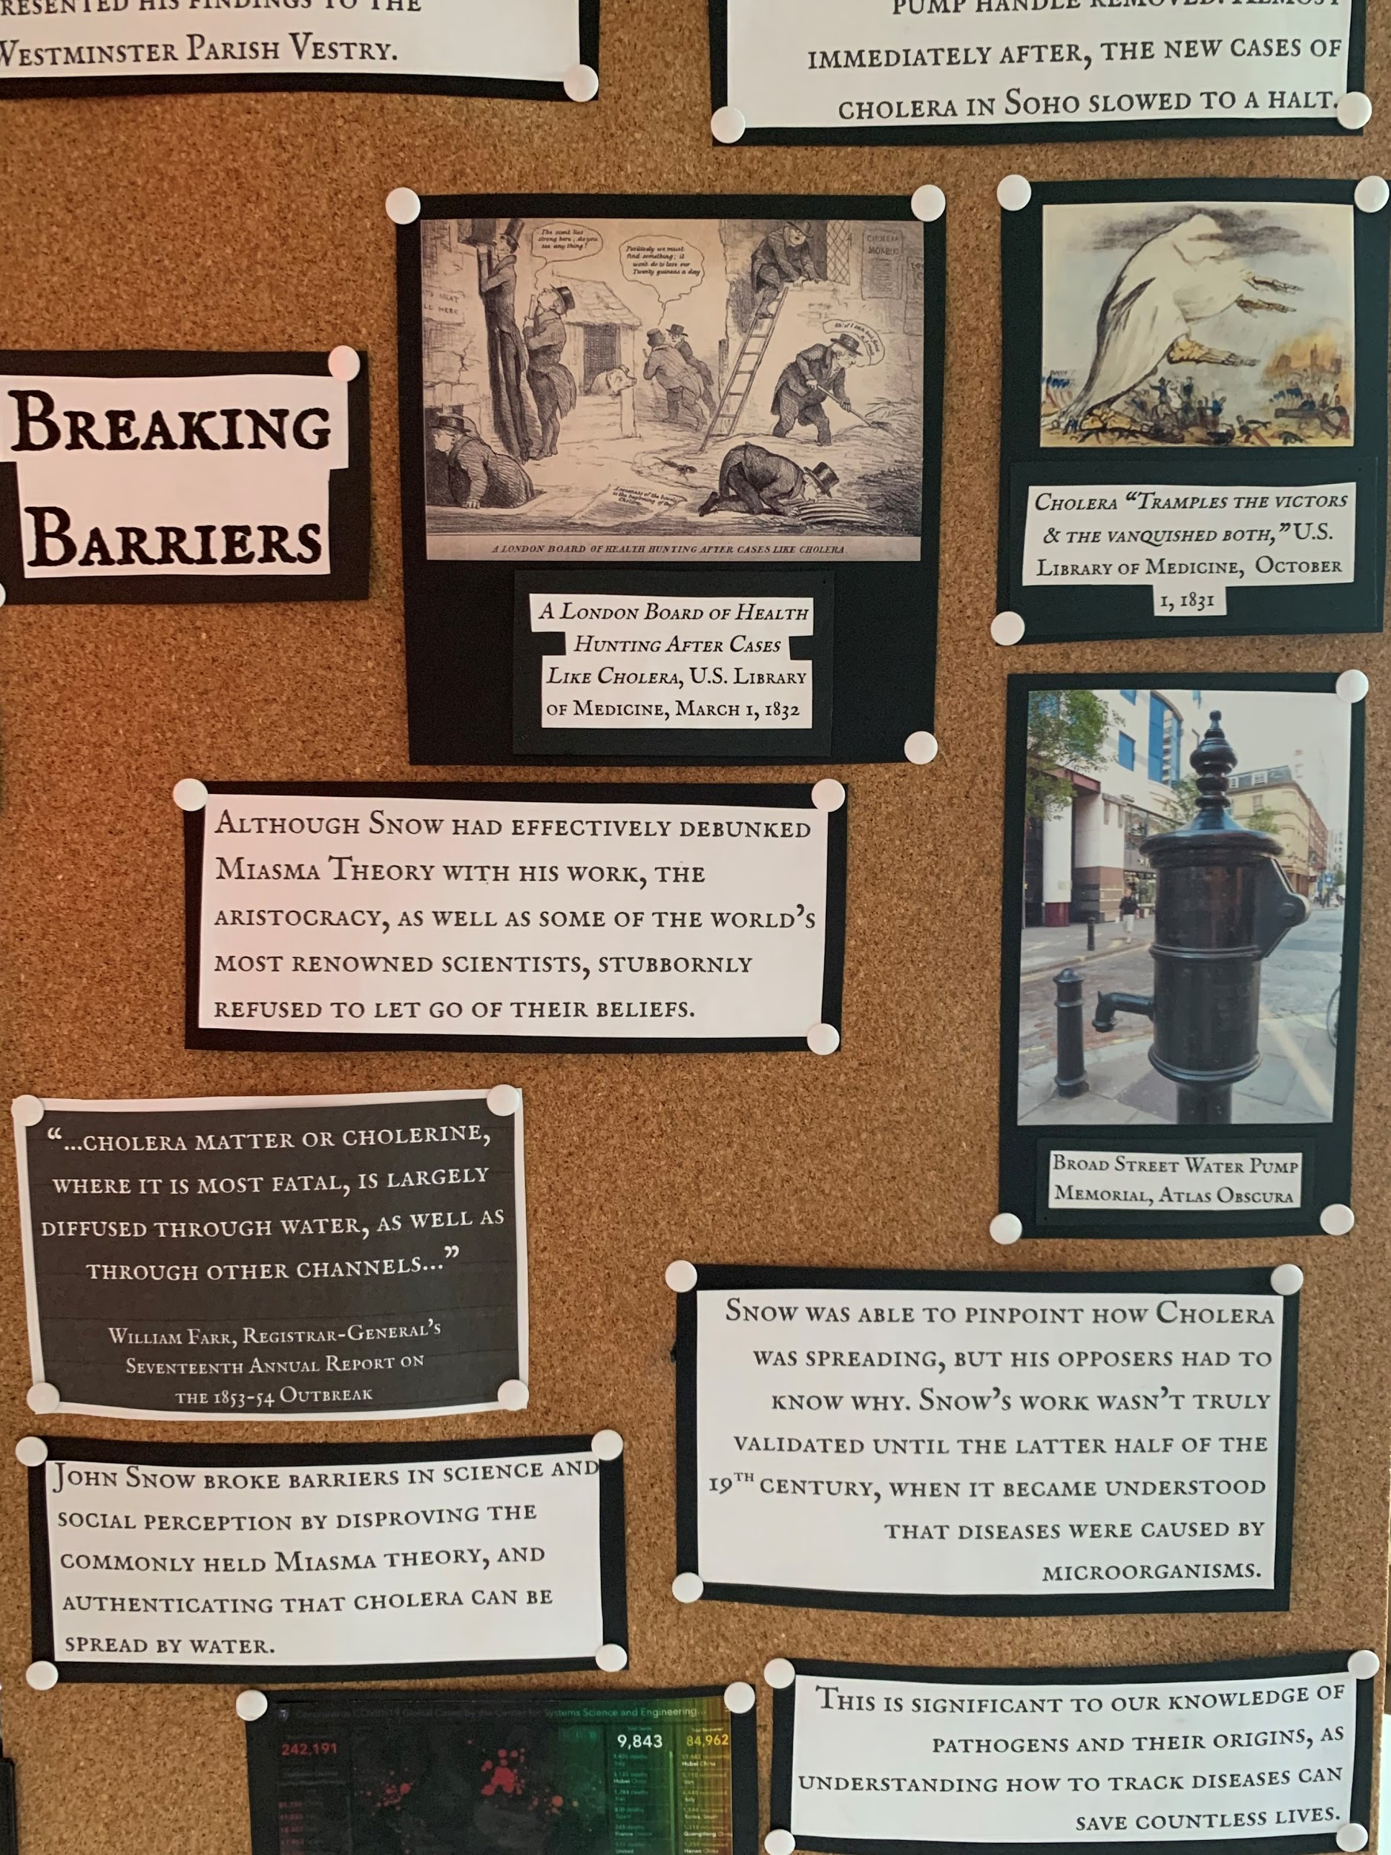
Right Panel Center Photo

Slide 15
Right Panel Center Text
Snow was able to pinpoint how Cholera was spreading, but his opposers had to know why. Snow’s work wasn’t truly validated until the latter half of the 19th century, when it became understood that diseases were caused by microorganisms.
John Snow broke barriers in science and social perception by disproving the commonly held Miasma theory, and authenticating that cholera can be spread by water.
“...cholera matter or cholerine, where it is most fatal, is largely diffused through water, as well as through other channels…”
-William Farr, Registrar-General's
Seventeenth Annual Report on
the 1853-54 Outbreak

Slide 16
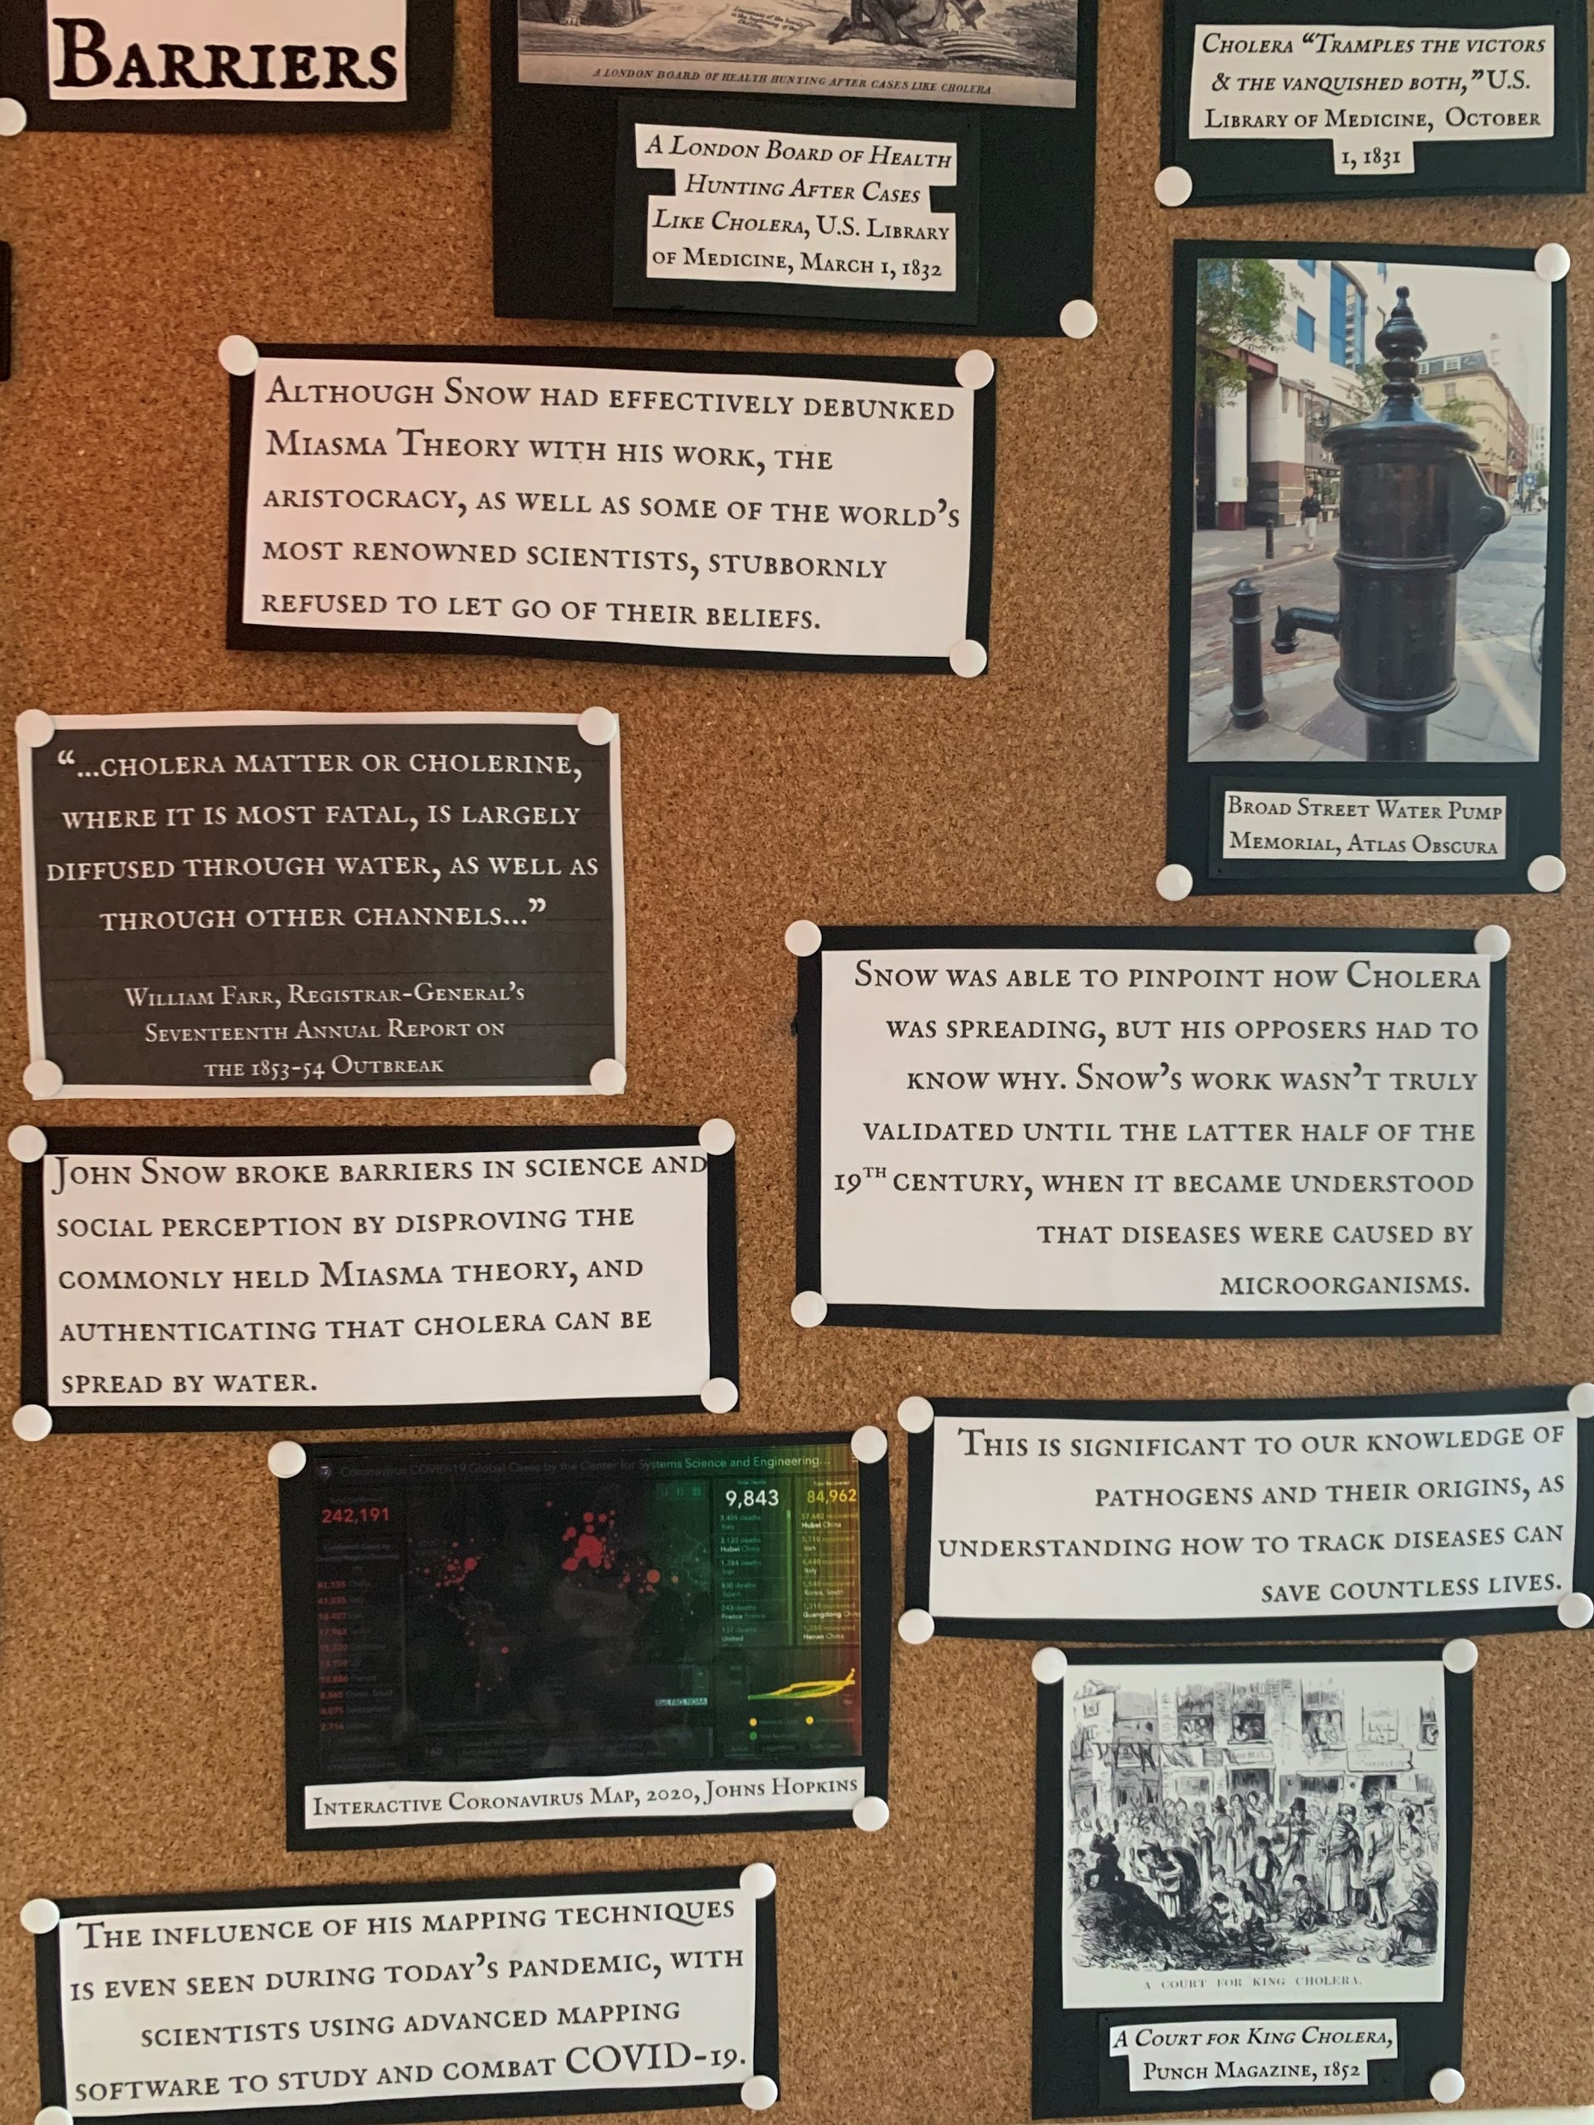
Right Panel Bottom Photo

Slide 17
Right Panel Bottom Text
This is significant to our knowledge of pathogens and their origins, as understanding how to track diseases can save countless lives.
The influence of his mapping techniques is even seen during today’s pandemic, with scientists using advanced mapping software to study and combat COVID-19.

